Slide 1

School of Computer Science and Applications(I MCA-A)
RELATIONAL DATABASE MANAGEMENT SYSTEM
Course Code: M23DE0103
Prof Nagaraj C

Slide 2
Topics discussed in unit - I
Structure of Relational Databases
Database Schema, Keys
Schema Diagrams
Relational Query Languages
Relational Operations
Database System Applications
Purpose of Database Systems
View of Data, Database Languages
Relational Databases
Databases Design
Data Storage and Querying
Transaction Management
Database Architecture
Database Users and Administrator

Slide 3
In Today’s class , we will discuss
Database Design - Overview
Design Phases

Slide 4
HIGH LEVEL CONCEPTUAL DATA MODELS FOR DATABASE DESIGN
The database design begins with the software requirement specifications of the given problem
The precise requirement collection is very important to have a good database design.
Next step is to create a conceptual schema that describes the data type,relationships and constraints.This is called conceptual design.
Implementation Model consists of two phases
1.Logical database design
2.Physical database design

Slide 5
HIGH LEVEL CONCEPTUAL DATA MODELS FOR DATABASE DESIGN
The database design phases consists of the following steps:
1.Requirement collection and analysis
2.Conceptual Design
3.Logical Design(Implementation of Data Model)
4.Physical Design

Slide 6
HIGH LEVEL CONCEPTUAL DATA MODELS FOR DATABASE DESIGN
1.Requirement collection and analysis:
During this phase, the database designers interview database users. This helps them to understand and document their data requirements.
2.Conceptual Design:
It describes data requirements of the users, entity types, relationships and constraints.These concepts do not include implementation details.

Slide 7
HIGH LEVEL CONCEPTUAL DATA MODELS FOR DATABASE DESIGN
3.Logical Design:
This step involves implementation of data model.Since conceptual schema is transformed from the high level model into the implementation data model is known as Data Model mapping.
This results in a database schema in the implementation data model such as relational or object oriented database model.
4.Physical Design:
Physical database design is the process of describing the implementation of the database on the disk,internal storage structures,access paths,relations ,security issues and constraints.

Slide 8
HIGH LEVEL CONCEPTUAL DATA MODELS FOR DATABASE DESIGN
Overall Data Base Design involves the following steps:
1.Identifying all the required files
2.Identifying the fields of each of these record types
3.Identifying the primary key of each of these files
4.Identifying the relationship between record types.

Slide 9
HIGH LEVEL CONCEPTUAL DATA MODELS FOR DATABASE DESIGN
Example Database Application:
Let us consider an example database application that demonstrates the basic ER model concepts and their use in schema design.
1.First the data requirements for the database are to be listed
2.Then its conceptual schema should be created step by step.
Consider COMPANY Database.This database keeps track of employees,department and projects.
This company can be organized into departments.Each department can have a unique name and a particular employee who is the manager of the department.

Slide 10
HIGH LEVEL CONCEPTUAL DATA MODELS FOR DATABASE DESIGN
Example Database Application:
Department controls a no.of projects,each of which has a unique name,unique number.
The company database will have the following relations with their respective attributes:
Department:DeptNo,DeptName,Dlocation,Manager
Project:Pno,Pname,Plocation
Employee:Eid,Ename,DeptNo,Addr,Sex,Salary,DOB
Dependent:DepID,DepName,sex,DOB,Relnship,Eid

Slide 11
Design Phases
Stated in terms of the entity-relationship model, the conceptual schema specifies
The entities that are represented in the database.
The attributes of the entities.
The relationships among the entities and
Constraints on the entities and relationships.

Slide 12
Design Phases
Typically, the conceptual-design phase results in
  the creation of an entity-relationship diagram that provides a graphic representation of the schema.
A fully developed conceptual schema also indicates the functional requirements of the enterprise.
In a specification of functional requirements, users describe the kinds of operations (or transactions) that will be performed on the data.
At this stage of conceptual design, the designer can review the schema to ensure it meets functional requirements.

Slide 13
Design Phases
In designing a database schema, we must ensure that we avoid two major pitfalls:
Redundancy
Incompleteness

Slide 14
Exercise Questions
Which are the different phases in database design?
Which are the tasks involved in Database application design?

Slide 15
The Entity-Relationship Model
Developed to facilitate database design by allowing specification of an enterprise schema that represents the overall logical structure of a database.
Very popular modeling tool among many such tools available today.
Many tools are available for data modeling with E-R. All tools have some variations in representation of components.
The E- R model provides:
An excellent communication tool.
A simple graphical representation of data.

Slide 16
The Entity-Relationship Model
The E-R data model employs three basic concepts:
Entity Sets
Relationship Sets and
Attributes
The E-R model also has an associated diagrammatic representation,
- the E-R diagram.

Slide 17
The Entity-Relationship Model
Entity - An entity is a “thing” or “object” in the real world that is distinguishable from all other objects.
Entity set - An entity set is a set of entities of the same type that share the same properties, or attributes.
An entity is represented by a set of attributes.
Each entity has a value for each of its attributes.
A database thus includes a collection of entity sets, each of which contains any number of entities of the same type.

Slide 18
The Entity-Relationship Model
R19CA001 | Abhilash
R19CA002 | Abhay
R19CA003 | Aradhya
R19CA004 | Bharath
R19CA005 | Babu
R19CA006 | Chethan
Entity Set Example:

Slide 19
The Entity-Relationship Model
Relationship Sets:
A relationship is an association among several entities.
A relationship set is a set of relationships of the same type.
Formally, it is a mathematical relation on n ≥ 2 (possibly nondistinct) entity sets.
If E1, E2, . . . , En are entity sets, then a relationship set R is a subset of
{ (e1, e2, . . . , en) | e1 ∈ E1, e2 ∈ E2, . . . , en ∈ En }
where (e1, e2, . . . , en) is a relationship.

Slide 20
The Entity-Relationship Model
A relationship instance in an E-R schema represents an association between the named entities in the real-world enterprise that is being modeled.
The function that an entity plays in a relationship is called that entity’s role.
The number of entity sets that participate in a relationship set is the degree of the relationship set.

Slide 21
The Entity-Relationship Model
Attributes
For each attribute, there is a set of permitted values, called the domain, or value set, of that attribute.
An attribute, as used in the E-R model, can be characterized by the following attribute types.
• Simple and composite attributes.
Simple Attributes can be divided into subparts.
Composite attributes, on the other hand, can be divided into subparts.

Slide 22
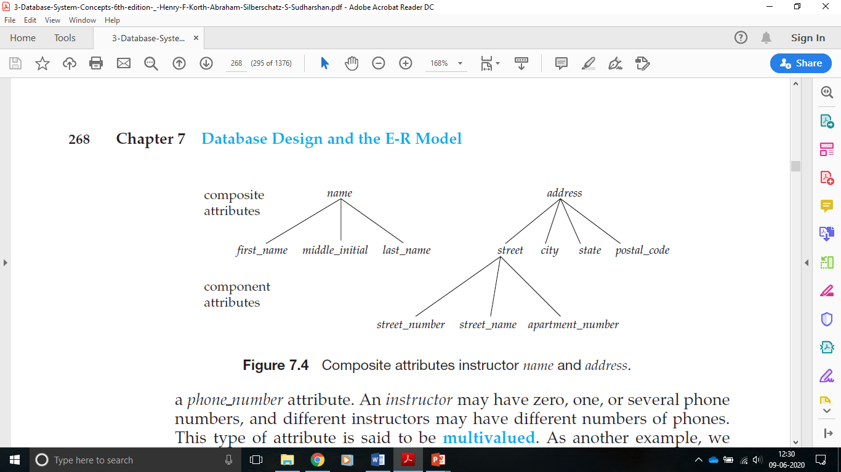
Composite Attributes:

Slide 23
The Entity-Relationship Model
Single-valued and multivalued attributes.
The attributes have a single value for a particular entity. Such attributes are said to be single valued.
There may be instances where an attribute has a set of values for a specific entity. That type of attribute is said to be multivalued.
Derived attribute. The value for this type of attribute can be derived from the values of other related attributes or entities.
An attribute takes a null value when an entity does not have a value for it.
The null value may indicate “not applicable”—that is, that the value does not exist for the entity.

Slide 24
The Entity-Relationship Model
EXAMPLES
  Simple attributes—attributes that cannot be subdivided;
  for example, last name, city, or gender.
  Composite attributes—attributes that can be subdivided, into atomic form; for example, a full name can be subdivided into the last name, first name, and middle initial.

Slide 25
The Entity-Relationship Model
EXAMPLES
  Single-valued attributes—attributes with a single value;
  for example, Employee ID, Social Security number, or date of birth.
  Multivalued attributes—attributes with multiple values;
  for example, degree codes or course registration.

Slide 26
Exercise Questions
Which are the different types of Attributes?
Which are the three basic concepts employed in E-R data model?

Slide 27
CONSTRAINTS on relationship types
An E-R enterprise schema may define certain constraints to which the contents of a database must conform.
Lets see:
Mapping Cardinalities and
Participation Constraints.

Slide 28
CONSTRAINTS
Mapping cardinalities, or cardinality ratios
express the number of entities to which another entity can be associated via a relationship set.

Slide 29
CONSTRAINTS
Participation Constraints
The participation of an entity set E in a relationship set R is said to be total if every entity in E participates in at least one relationship in R.
If only some entities in E participate in relationships in R, the participation of entity set E in relationship R is said to be partial.

Slide 30
Relationship between entity set
For a binary relationship set R between entity sets A and B, the mapping cardinality must be one of the following:
One-to-one. An entity in A is associated with at most one entity in B, and an entity in B is associated with at most one entity in A.
One-to-many. An entity in A is associated with any number (zero or more) of entities in B. An entity in B, however, can be associated with at most one entity in A.
Many-to-one. An entity in A is associated with at most one entity in B. An entity in B, however, can be associated with any number (zero or more) of entities in A.
Many-to-many. An entity in A is associated with any number (zero or more) of entities in B, and an entity in B is associated with any number (zero or more) of entities in A.

Slide 31
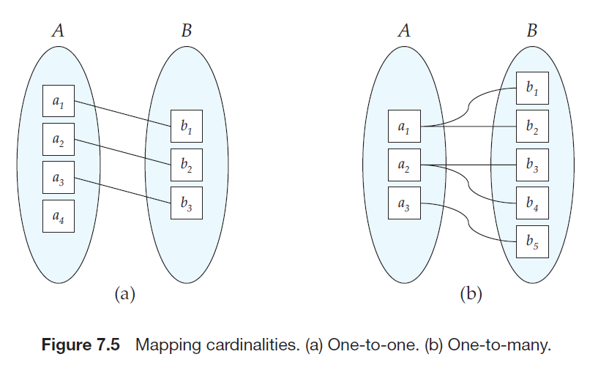
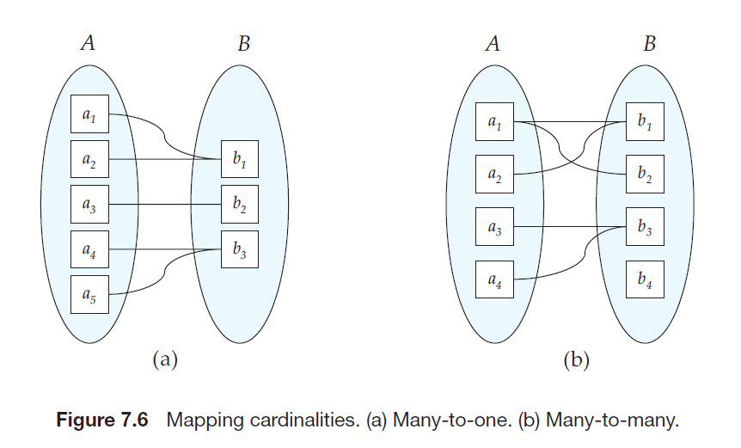
Example:

Slide 32
What are Keys?
An attribute or set of an attribute which helps you to identify a row(tuple) in a relation(table).
Allow you to find the relation between two tables.
Keys help you uniquely identify a row in a table by a combination of one or more columns in that table.

Slide 33
Why we need a Key?
Help you to identify any row of data in a table.
In a real-world application, a table could contain thousands of records.
Moreover, the records could be duplicated.
Keys ensure that you can uniquely identify a table record despite these challenges.
Allows you to establish a relationship between and identify the relation between tables
Help you to enforce identity and integrity in the relationship.

Slide 34
Various Keys in DBMS
Super Key
Primary Key
Candidate Key
Alternate Key
Foreign Key
Composite Key
Surrogate Key

Slide 35
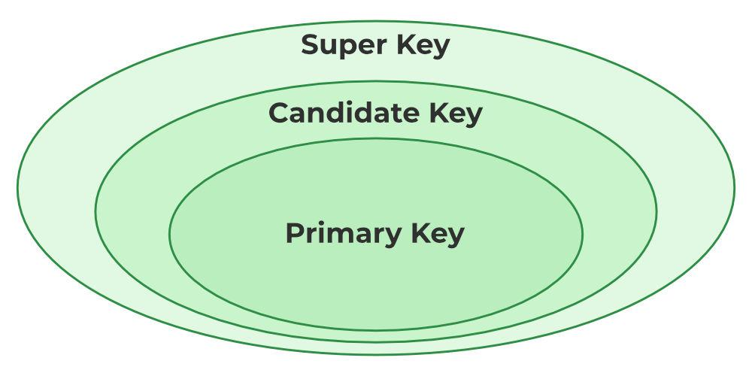
Various Keys in DBMS

Slide 36
Various Keys in RDBMS
Primary Key
There can be more than one candidate key in relation out of which one can be chosen as the primary key. For Example, STUD_NO, as well as STUD_PHONE, are candidate keys for relation STUDENT but STUD_NO can be chosen as the primary key (only one out of many candidate keys).
A primary key is a unique key, meaning it can uniquely identify each record (tuple) in a table.
It must have unique values and cannot contain any duplicate values.
A primary key cannot be NULL, as it needs to provide a valid, unique identifier for every record.
A primary key does not have to consist of a single column. In some cases, a composite primary key (made of multiple columns) can be used to uniquely identify records in a table.
Databases typically store rows ordered in memory according to primary key for fast access of records using primary key.

Slide 37
Various Keys in RDBMS
Alternate Key
An alternate key is any candidate key in a table that is not chosen as the primary key. In other words, all the keys that are not selected as the primary key are considered alternate keys.
An alternate key is also referred to as a secondary key because it can uniquely identify records in a table, just like the primary key.
An alternate key can consist of one or more columns (fields) that can uniquely identify a record, but it is not the primary key
Eg:- PAN, and AADHAR is Alternate keys

Slide 38
Various Keys in RDBMS
Candidate Key
The minimal set of attributes that can uniquely identify a tuple is known as a candidate key. For Example, STUD_NO in STUDENT relation.
A candidate key is a minimal super key, meaning it can uniquely identify a record but contains no extra attributes.
The minimal set of attributes that can uniquely identify a record.
A candidate key must contain unique values, ensuring that no two rows have the same value in the candidate key’s columns.
Every table must have at least a single candidate key.
A table can have multiple candidate keys but only one primary key.
Artificial Key
An Artificial Key is artificially created by the system when no suitable natural key or candidate key is available.
It is usually an auto-incremented numeric value (like an ID column) that uniquely identifies each record in a table.

Slide 39
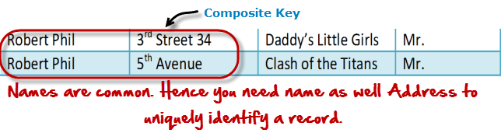
Various Keys in RDBMS
Super Key
The set of one or more attributes (columns) that can uniquely identify a tuple (record) is known as Super Key.
For Example, STUD_NO, (STUD_NO, STUD_NAME), etc.
A super key is a group of single or multiple keys that uniquely identifies rows in a table. It supports NULL values in rows.
A super key can contain extra attributes that aren’t necessary for uniqueness. For example, if the “STUD_NO” column can uniquely identify a student, adding “SNAME” to it will still form a valid super key, though it’s unnecessary.
Composite Key
A combination of two or more columns that uniquely identifies a row.
Used when a single column cannot uniquely identify a record.
Example: (Course_ID, Student_ID) in an Enrollment table.

Slide 40
Various Keys in RDBMS
Surrogate Key
A system-generated unique key, usually an auto-increment field.(In Oracle IDENTITY)
Used when no natural primary key exists.
Example: Order_ID in an Orders table.
Foreign Key
A foreign key is an attribute in one table that refers to the primary key in another table. The table that contains the foreign key is called the referencing table, and the table that is referenced is called the referenced table.
A foreign key in one table points to the primary key in another table, establishing a relationship between them.
It helps connect two or more tables, enabling you to create relationships between them. This is essential for maintaining data integrity and preventing data redundancy.
They act as a cross-reference between the tables.
For example, DNO is a primary key in the DEPT table and a non-key in EMP

Slide 41
Summary
Constraints
Mapping Cardinalities and
Participation Constraints.
Keys
Types of Keys

Slide 42
Exercise Questions
Which are the different types of keys?
Different mapping cardinalities.

Slide 43
Removing Redundant Attributes in Entity Sets
When we design a database using the E-R model, we usually start by identifying those entity sets that should be included.
Once the entity sets are decided upon, we must choose the appropriate attributes.
These attributes are supposed to represent the various values we want to capture in the database.

Slide 44
Removing Redundant Attributes in Entity Sets
Once the entities and their corresponding attributes are chosen, the relationship sets among the various entities are formed.
These relationship sets may result in a situation where attributes in the various entity sets are redundant and need to be removed from the original entity sets.
A good entity-relationship design does not contain redundant attributes.

Slide 45
Example:
classroom: with attributes (building, room number, capacity).
• department: with attributes (dept name, building, budget).
• course: with attributes (course id, title, credits).
• instructor: with attributes (ID, name, salary).
• section: with attributes (course id, sec id, semester, year).
• student: with attributes (ID, name, tot cred).
• time slot: with attributes (time slot id, {(day, start time, end time) }).
The relationship sets in our design are listed below:
• inst_dept: relating instructors with departments.
• stud_dept: relating students with departments.
• teaches: relating instructors with sections.
• takes: relating students with sections, with a descriptive attribute grade.
• course_dept: relating courses with departments.
• sec_course: relating sections with courses.
• sec_class: relating sections with classrooms.
• sec_time_slot: relating sections with time slots.
• advisor: relating students with instructors.
• prereq: relating courses with prerequisite courses.

Slide 46
Exercise Questions
1. ..............is a ‘thing’ in the real world with an independent existence.
A) Entity
B) Attribute
C) Key
D) Relationship
ANSWER: A
2. The relational model feature is that there
(A) is no need for primary key data.
(B) is much more data independence than some other database models.
(C) are explicit relationships among records.
(D) are tables with many dimensions.
ANSWER: B

Slide 47
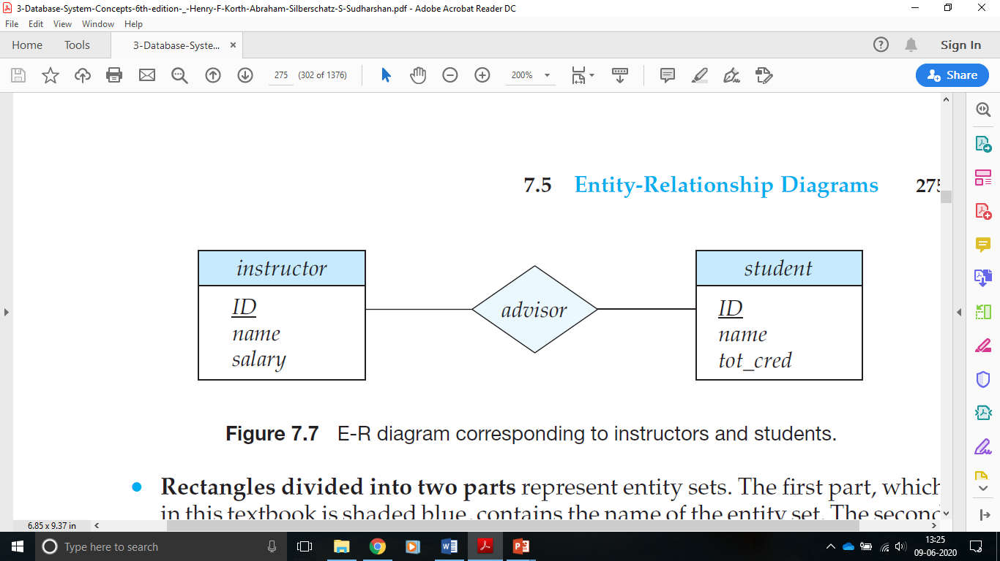
Entity-Relationship Diagrams
An E-R diagram can express the overall logical structure of a database graphically.
E-R diagrams are simple and clear.

Slide 48
An E-R diagram consists of the following major components:
Rectangle: Represents Entity sets.
Ellipses: Attributes
Diamonds: Relationship Set
Lines: They link attributes to Entity Sets and Entity sets to Relationship Set
Double Ellipses: Multivalued Attributes
Dashed Ellipses: Derived Attributes
Double Rectangles: Weak Entity Sets
Double Lines: Total participation of an entity in a relationship set

Slide 49
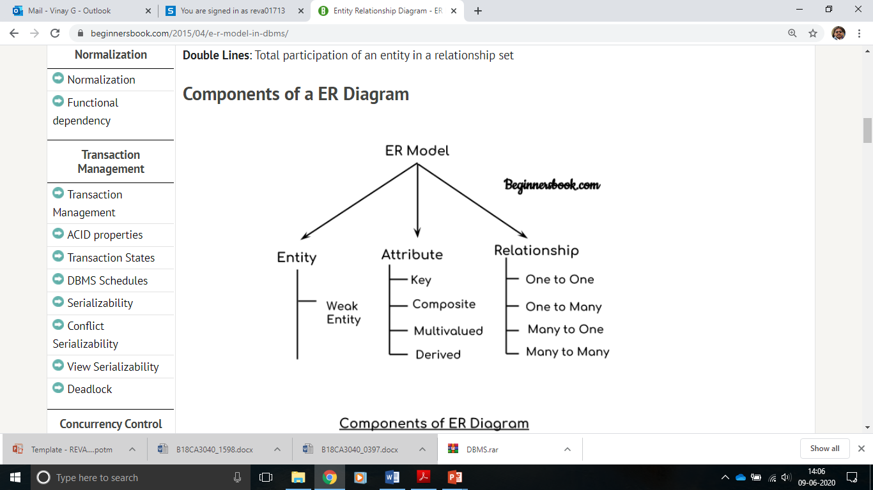

Slide 50
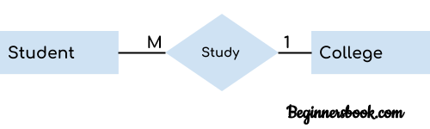
Entity
An object or component of data.
An entity is represented as rectangle in an ER diagram.
For example:

Slide 51
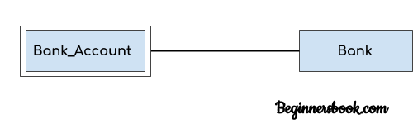
Weak Entity:
An entity that cannot be uniquely identified by its own attributes and relies on the relationship with other entity is called weak entity.
The weak entity is represented by a double rectangle.
For example – a bank account cannot be uniquely identified without knowing the bank to which the account belongs, so bank account is a weak entity.

Slide 52
ATTRIBUTE
An attribute describes the property of an entity.
An attribute is represented as Oval in an ER diagram.
There are four types of attributes:
1. Key attribute
2. Composite attribute
3. Multivalued attribute
4. Derived attribute

Slide 53
Key attribute:
A key attribute can uniquely identify an entity from an entity set.
For example, student roll number can uniquely identify a student from a set of students.
Represented by oval same as other attributes however the text of key attribute is underlined.
Stu_Id

Slide 54
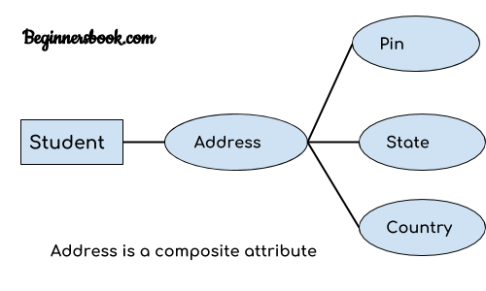
Composite attribute:
An attribute that is a combination of other attributes
For example, In student entity, the student address is a composite attribute as an address is composed of other attributes such as pin code, state, country.

Slide 55
ATTRIBUTE
Multivalued attribute:
An attribute that can hold multiple values is known as multivalued attribute.
It is represented with double ovals in an ER Diagram.
For example – A person can have more than one phone numbers so the phone number attribute is multivalued.

Slide 56
ATTRIBUTE
Derived attribute:
A derived attribute is one whose value is dynamic and derived from another attribute.
It is represented by dashed oval in an ER Diagram.
For example – Person age is a derived attribute as it changes over time and can be derived from another attribute (Date of birth).

Slide 57
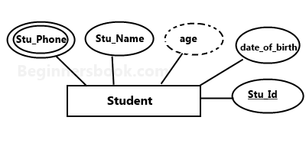
ATTRIBUTE
E-R diagram with multivalued and derived attributes:

Slide 58
Relationship
Represented by diamond shape in ER diagram
Shows the relationship among entities.
Four types -
1. One to One
2. One to Many
3. Many to One
4. Many to Many

Slide 59
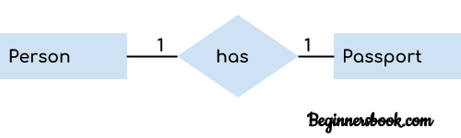
One to One Relationship
When a single instance of an entity is associated with a single instance of another entity then it is called one to one relationship.
For example, a person has only one passport and a passport is given to one person.

Slide 60
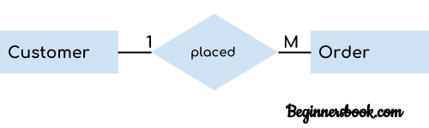
One to Many Relationship
When a single instance of an entity is associated with more than one instances of another entity then it is called one to many relationship.
For example – a customer can place many orders but a order cannot be placed by many customers.

Slide 61
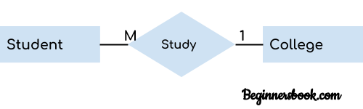
Many to One Relationship
When more than one instances of an entity is associated with a single instance of another entity then it is called many to one relationship.
For example – many students can study in a single college but a student cannot study in many colleges at the same time.

Slide 62
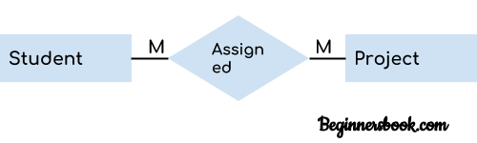
Many to Many Relationship
When more than one instances of an entity is associated with more than one instances of another entity then it is called many to many relationship.
For example, a can be assigned to many projects and a project can be assigned to many students.

Slide 63
Total Participation of an Entity set
A Total participation of an entity set represents that each entity in entity set must have at least one relationship in a relationship set.
For example: In the below diagram each college must have at-least one associated Student.
Stu_Name
Col_Id
Col_Name
Stu_Id
Stu_Addr
Study in
Student
College

Slide 64
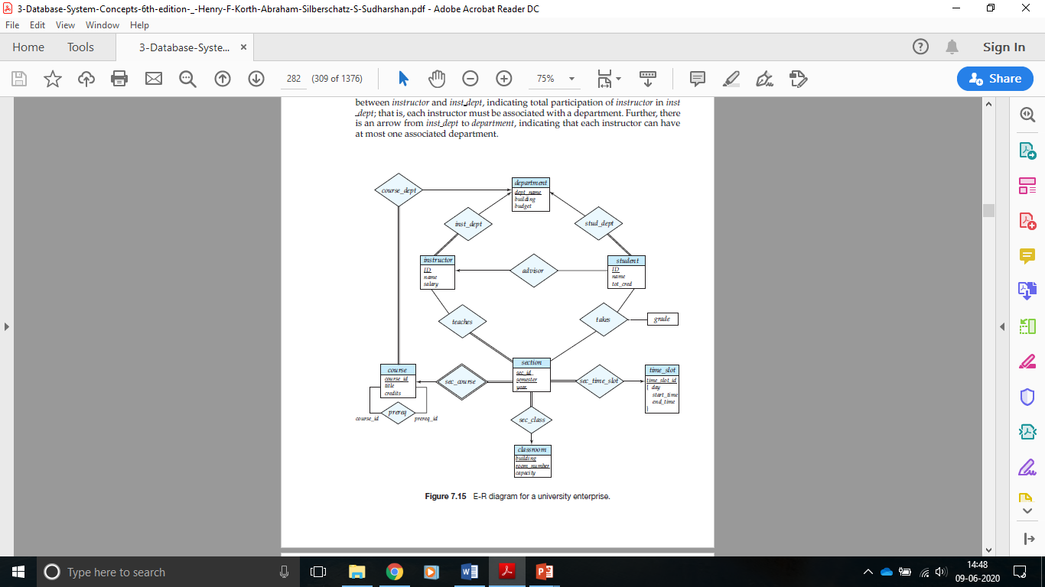
Example

Slide 65
Exercise Questions
E-R model uses this symbol to represent weak entity set ?
(A) Dotted rectangle.
(B) Diamond
(C) Doubly outlined rectangle
(D) None of these
ANSWER: C
In E-R Diagram relationship type is represented by
(A) Ellipse
(B) Dashed ellipse
(C) Rectangle
(D) Diamond
ANSWER: D

Slide 66
Reduction to Relational Schemas
Both the E-R model and the relational database model are abstract, logical representations of real-world enterprises.
Because the two models employ similar design principles, we can convert an E-R design into a relational design.
Representation of Strong Entity Sets with Simple Attributes
Representation of Strong Entity Sets with Complex Attributes
Representation of Weak Entity Sets
Representation of Relationship Sets
    Redundancy of Schemas
    Combination of Schemas

Slide 67
Relational Database Design
The goal of Relational Database Design is to generate a set of relation schemas that allows us to store information without unnecessary redundancy, yet also allows us to retrieve information easily.
This is accomplished by designing schemas that are in an appropriate normal form.

Slide 68
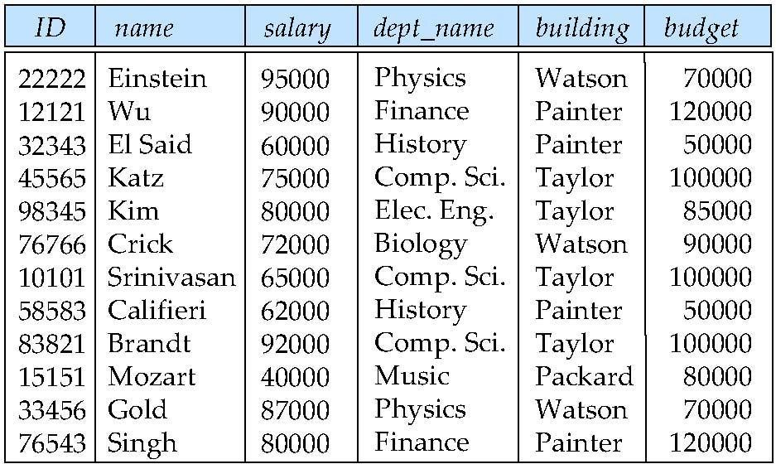
Features of Good Relational Designs
Combine Schemas?
Suppose we combine instructor and department into inst_dept
  (No connection to relationship set inst_dept)
Result is possible repetition of information

Slide 69
Features of Good Relational Designs
A Combined Schema without Repetition
Consider combining relations
  sec_class(sec_id, building, room_number) and
  section(course_id, sec_id, semester, year)
into one relation
  section(course_id, sec_id, semester, year, building, room_number)
No repetition in this case

Slide 70
Features of Good Relational Designs
What About Smaller Schemas?
Suppose we had started with inst_dept. How would we know to split up (decompose) it into instructor and department?
Write a rule ―if there were a schema (dept_name, building, budget), then
dept_name would be a candidate key‖
Denote as a functional dependency:
dept_name → building, budget

Slide 71
Features of Good Relational Designs
What About Smaller Schemas?
In inst_dept, because dept_name is not a candidate key, the building and budget of a department may have to be repeated.
This indicates the need to decompose inst_dept
Not all decompositions are good. Suppose we decompose
employee(ID, name, street, city, salary) into
employee1 (ID, name)
employee2 (name, street, city, salary)

Slide 72
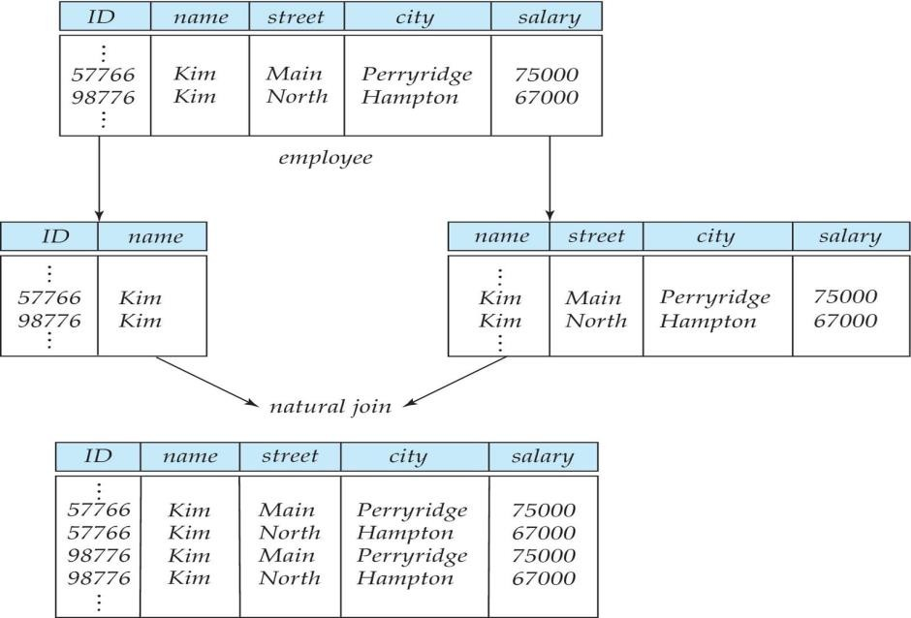
A Lossy Decomposition
The figure shows how we lose information -- we cannot reconstruct the original employee relation -- and so, this is a Lossy Decomposition.

Slide 73
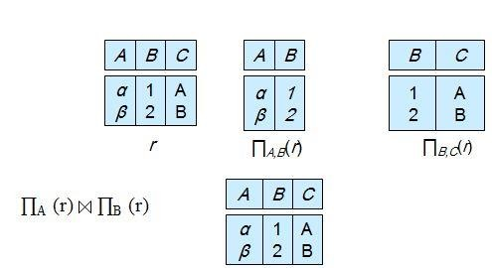
Example of Lossless-Join Decomposition
Lossless join decomposition
Decomposition of R = (A, B, C)
R ₁ = (A, B) R ₂ = (B, C)

Slide 74
DEPENDENCY
You learned that the primary key in a table identifies an entity.
Every table in the database should have a primary key, which uniquely identifies an entity.
For example, PartNo is a primary key in the PARTS table, and DeptNo is a primary key in the DEPARTMENT table.
You should define a primary key for all tables for integrity of data.

Slide 75
DEPENDENCY
Each table has other columns that do not make up the primary key for the table.
Such columns are called the non-key columns. The nonkey columns are functionally dependent on the primary key column.
For example, PartDesc and Cost in the PARTS table are dependent on the primary key PartNo, and DeptName is dependent on the primary key DeptNo in the DEPARTMENT table.

Slide 76
INVOICE
Inv No | InvDate | CustN | ItemNo | CustName | ItemName | ItemPrice | Qty
1001 | 04/14/20 | 212 | 1 | Mutthu | Screw | Rs. 2.25 | 5
1001 | 04/14/20 | 212 | 3 | Pandian | Bolt | Rs.3.99 | 5
1001 | 04/14/20 | 212 | 5 | Ramesh | Washer | Rs.1.99 | 9
1002 | 04/17/20 | 225 | 1 | Suresh | Screw | Rs.2.25 | 2
1002 | 04/17/20 | 225 | 2 | Ravi | Nut | Rs.5.00 | 3
1003 | 04/17/20 | 239 | 1 | Kapur | Screw | Rs.2.25 | 7
1003 | 04/17/20 | 239 | 2 | Kapur | Nut | Rs.5.00 | 1
1004 | 04/18/20 | 211 | 4 | Kohli | Hammer | Rs.9.99 | 5

Slide 77
INVOICE
The INVOICE table in does not have any single column that can uniquely identify an entity. The first choice would be InvNo.
It is not a unique value in the table, however, because an invoice may contain more than one item and there may be more than one entry for an invoice.
CustNo cannot be the primary key, because there can be many invoices for a customer and CustNo does not identify an invoice.

Slide 78
INVOICE
ItemNo cannot be the primary key either, because an item may appear in more than one invoice and ItemNo does not describe an invoice.
The table has a composite primary key, which consists of InvNo and ItemNo.
InvNo and ItemNo together make up unique values for each row. All other columns that do not constitute the primary key are nonkey columns, and they are dependent on the primary key.

Slide 79
Functional Dependency
There are three types of dependencies in a table:
Total or full dependency: A nonkey column dependent on all primary key columns shows total dependency.
Partial dependency: In partial dependency, a nonkey column is dependent on part of the primary key.
Transitive dependency: In transitive dependency, a nonkey column is dependent on another nonkey column.

Slide 80
Functional Dependency
For example, in the INVOICE table, ItemName and ItemPrice are nonkey columns that are dependent only on a part of the primary key column ItemNo. They are not dependent on the InvNo column. It is said to have Partial dependency.
Similarly, the nonkey column InvDate is dependent only on InvNo. They are partially dependent on the primary key columns.

Slide 81
Functional Dependency
The nonkey column CustName is not dependent on any primary key column but is dependent on another nonkey column, CustNo. It is said to have transitive dependency.
The nonkey column Qty is dependent on both InvNo and ItemNo, so it is said to have full dependency.

Slide 82
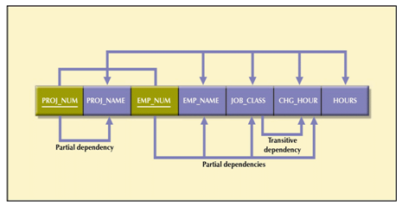
Functional Dependency
A relationship between attributes in which one or more attributes determines the value of another attribute(s) in the same table
  The Proj_Num “determines” the Proj_Name

Slide 83
Exercise Questions
What is Functional Dependency?
What are its Types?

Slide 84
Anomalies
Database anomaly is normally the flaw in databases which occurs because of poor planning and storing everything in a flat database.
Generally this is removed by the process of normalization which is performed by splitting/joining of tables.

Slide 85
Anomalies
The general definition of an anomaly is something that you don't expect.
An insertion anomaly occurs when the information about an entity cannot be inserted unless the information about another entity is known.
A deletion anomaly results when the deletion of information about one entity leads to the deletion of information about another entity.
An update anomaly can occurs when redundant data in a poorly normalized database causes inconsistent or partial updates, leading to data integrity issues.This happens when multiple occurrences of the same data exist in a table, and an update to one instance does not automatically update all related instances.

Slide 86
Normalization IN RDBMS
Normalization is a database design technique that reduces data redundancy and eliminates undesirable characteristics like Insertion, Update and Deletion Anomalies.
Normalization rules divides larger tables into smaller tables and links them using relationships.
The purpose of Normalization in SQL is to eliminate redundant (repetitive) data and ensure data is stored logically.
The inventor of the relational model Edgar F Codd proposed the theory of normalization of data with the introduction of the First Normal Form, and he continued to extend theory with Second and Third Normal Form.
Later he joined Raymond F. Boyce to develop the theory of Boyce-Codd Normal Form.

Slide 87
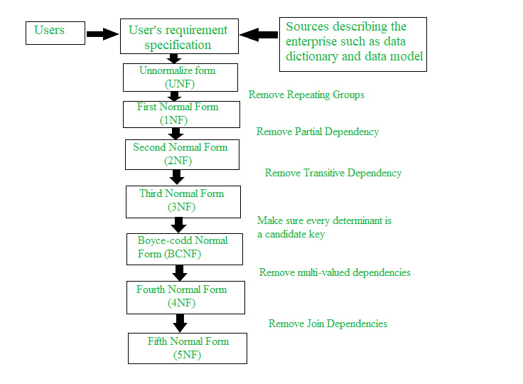
Normalization IN RDBMS

Slide 88
Advantages of Normal Form
Normalization
Reduced data redundancy: Normalization helps to eliminate duplicate data in tables, reducing the amount of storage space needed and improving database efficiency.
Improved data consistency: Normalization ensures that data is stored in a consistent and organized manner, reducing the risk of data inconsistencies and errors.
Simplified database design: Normalization provides guidelines for organizing tables and data relationships, making it easier to design and maintain a database.
Improved query performance: Normalized tables are typically easier to search and retrieve data from, resulting in faster query performance.
Easier database maintenance: Normalization reduces the complexity of a database by breaking it down into smaller, more manageable tables, making it easier to add, modify, and delete data.

Slide 89
1st Normal Form (1NF) – Eliminate Repeating Groups
Normalization
A table is said to be in first normal form, or can be labeled INF, if the following conditions exist:
All columns contain atomic (single) value.
Each column contains values of a single type.
There are no duplicate rows.

Slide 90
Example of a Non-1NF Table Converted to 1NF
❌ Problem: The Subjects column has multiple values.
✅ Solution: Each cell contains a single value, removing repeating groups.
Student_ID | Name | Subjects
101 | Hashvik | Math, Science
102 | Jashvika | English, History
Student_ID | Name | Subject
101 | Hashvik | Math
101 | Hashvik | Science
102 | Jashvika | English
102 | Jashvika | History

Slide 91
SECOND Normal Form (2NF)– Remove Partial Dependency
Normalization
A table is said to be in second normal form, or 2NF, if the following requirements are satisfied:
  All 1NF requirements are fulfilled.
  All non-key attributes are fully dependent on the primary key.There is no partial dependency.

Slide 92
Example of a Non-2NF Table Converted to 2NF (Splitting into two tables)
Normalization
Student_ID | Subject | Teacher | Teacher_Age
101 | Math | Mr. A | 45
101 | Science | Mrs. B | 38
102 | English | Mr. C | 50
Student_ID | Subject | Teacher
101 | Math | Mr. A
101 | Science | Mrs. B
102 | English | Mr. C
T_ID | Teacher | Teacher_Age
1 | Mr. A | 45
2 | Mrs. B | 38
3 | Mr. C | 50
❌ Problem: Teacher_Age depends only on Teacher, not Student_ID + Subject.
✅ Solution: Now, Teacher_Age depends only on Teacher ID, avoiding partial dependency.

Slide 93
3rd Normal Form (3NF) – Remove Transitive Dependency
A table is in 3NF if:
It is already in 2NF.
There is no transitive dependency (i.e., non-key attributes should not be dependent on another non-key attributes, Its only on the primary key).
Example of a Non-3NF Table
Student_ID | Name | City | Zip_Code | State
101 | Aju | Coimbatore | 641018 | TN
102 | Dheeraj | Bangalore | 560001 | KA
❌ Problem: City and State depend on Zip_Code, not Student_ID (transitive dependency).

Slide 94
3rd Normal Form (3NF) – Remove Transitive Dependency
Converted to 3NF
Students Table Zip_Codes Table
✅ Solution: Now, City and State depend only on Zip_Code, removing transitive dependency.
Student_ID | Name | Zip_Code
101 | Aju | 641018
102 | Dheeraj | 560001
Zip_Code | City | State
641018 | Coimbatore | TN
560001 | Bangalore | KA

Slide 95
Normal Form | Condition | Example Fix
1NF | No repeating groups | Break multi-value columns into separate rows
2NF | No partial dependency | Move columns that don’t fully depend on the primary key to another table
3NF | No transitive dependency | Move indirectly related columns to a new table

Slide 96
What is Functional Dependency in DBMS?
Functional dependency in DBMS is an important concept that describes the relationship between attributes (columns) in a table. It shows that the value of one attribute determines the other.
It is denoted as X → Y, where the attribute set on the left side of the arrow, X is called Determinant, and Y is called the Dependent.
Example:
Suppose we have a student table with attributes: Stu_Id, Stu_Name, Stu_Age. Here Stu_Id attribute uniquely identifies the Stu_Name attribute of student table because if we know the student id we can tell the student name associated with it. This is known as functional dependency and can be written as Stu_Id→Stu_Name or in words we can say Stu_Name is functionally dependent on Stu_Id.

Slide 97
Functional Dependency
There are three types of dependencies in a table:
Total or full dependency: A nonkey column dependent on all primary key columns shows total dependency.
Partial dependency: In partial dependency, a nonkey column is dependent on part of the primary key.
Transitive dependency: In transitive dependency, a nonkey column is dependent on another nonkey column.

Slide 98
Roll_no | Name | dept_name | dept_building
42 | RAVI | CO | A4
43 | RAM | IT | A3
44 | SSS | CO | A4
45 | xyz | IT | A3
46 | mno | EC | B2
47 | jkl | ME | B2
From the above table we can conclude some valid functional dependencies:
roll_no → { name, dept_name, dept_building }→ Here, roll_no can determine values of fields name, dept_name and dept_building, hence a valid Functional dependency
roll_no → dept_name , Since, roll_no can determine whole set of {name, dept_name, dept_building}, it can determine its subset dept_name also.
dept_name → dept_building , Dept_name can identify the dept_building accurately, since departments with different dept_name will also have a different dept_building
More valid functional dependencies: roll_no → name, {roll_no, name} ⇢ {dept_name, dept_building}, etc.

Slide 99
Here are some invalid functional dependencies:
name → dept_name Students with the same name can have different dept_name, hence this is not a valid functional dependency.
dept_building → dept_name There can be multiple departments in the same building. Example, in the above table departments ME and EC are in the same building B2, hence dept_building → dept_name is an invalid functional dependency.

Slide 100
Boyce Codd normal form (BCNF)
Normalization
It is an advance version of 3NF that’s why it is also referred as 3.5NF.
BCNF is stricter than 3NF.
A table complies with BCNF if it is in 3NF and for every functional dependency
X->Y, X should be the super key of the table.

Slide 101
Converted to BCNF
Non-BCNF Table Student Table Course Table
S,C→T
S,T→C T→C
Student | Tutor
101 | Sandeep
101 | Sarathi
102 | Sandeep
102 | Sathvik
Course | Tutor
JAVA | Sandeep
Python | Sarathi
Python | Sathvik
Student | Course | Tutor
101 | JAVA | Sandeep
101 | Python | Sarathi
102 | JAVA | Sandeep
102 | Python | Sathvik

Slide 102
Multi-Valued Dependency (MVD)
A multi-valued dependency exists when one attribute in a table can have multiple values independently of another attribute.
This can lead to unnecessary duplication and redundancy.

Slide 103
4th Normal Form (4NF)
What is 4th Normal Form (4NF)?
The 4th Normal Form (4NF) is an advanced level of database normalization that deals with multi-valued dependencies. It ensures that a database table does not contain more than one independent multi-valued dependency.
A table is in 4NF if:
It is already in 3rd Normal Form (3NF).
It has no multi-valued dependencies, meaning that if one attribute in a table has multiple values that are independent of another attribute, those values should be stored in separate tables.

Slide 104
Example of a Table NOT in 4NF:
Consider a university database storing professors, courses they teach, and the committees they are part of.
Professor | Course | Committee
Dr. Smith | DBMS | Research Board
Dr. Smith | DBMS | Ethics Board
Dr. Smith | AI | Research Board
Dr. Smith | AI | Ethics Board
Dr. Jones | ML | Finance Board
Dr. Jones | ML | Ethics Board
Problem:
A professor can teach multiple courses.
A professor can be part of multiple committees.
These two facts are independent but stored together, causing data redundancy.

Slide 105
How to Convert to 4NF?
To remove the multi-valued dependency, we divide the table into two separate tables.
Table 1: Professor-Course Table 2: Professor-Committee
Professor | Committee
Dr. Smith | Research Board
Dr. Smith | Ethics Board
Dr. Jones | Finance Board
Dr. Jones | Ethics Board
Professor | Course
Dr. Smith | DBMS
Dr. Smith | AI
Dr. Jones | ML

Slide 106
Informal Design Guidelines for Relational Schema and Their Significance
When designing a relational database schema, informal design guidelines help ensure efficiency, consistency, and data integrity. These guidelines prevent issues such as data redundancy, anomalies, excessive NULL values, and poor organization.
1. Avoid Redundant Data (Minimize Redundancy)
Guideline:
Ensure that data is not repeated unnecessarily in a table to reduce storage costs and prevent inconsistencies.
Significance:
✅ Reduces storage requirements.
✅ Prevents data inconsistency during updates.
✅ Improves database performance.

Slide 107
Example:
Consider the following unnormalized table:
Issue:
The Dept_Name and Dept_Location are repeated for every employee in the same department.
Updating a department's location requires updating multiple rows, leading to update anomalies.
Emp_ID | Emp_Name | Dept_ID | Dept_Name | Dept_Location
101 | Raghu | D01 | HR | Mangalore
102 | Varun | D02 | IT | Chennai
103 | Tejas | D03 | testing | Mangalore

Slide 108
Solution (Normalization - Splitting Tables):
Employee Table Department Table
Emp_ID | Emp_Name | Dept_ID
101 | Raghu | D01
102 | Varun | D02
103 | Tejas | D01
Dept_ID | Dept_Name | Dept_Location
D01 | HR | Mangalore
D02 | IT | Chennai
💡 Now, the department details are stored separately, eliminating redundancy.

Slide 109
2. Reduce Update, Insertion, and Deletion Anomalies
A well-structured schema should prevent anomalies that occur during updates, insertions, or deletions.
Significance:
✅ Prevents loss of critical data during deletion.
✅ Ensures consistency in data modification.
✅ Simplifies data management.
Example (Deletion Anomaly):
If an EMPLOYEE and DEPARTMENT are stored in the same table, deleting the last employee in a department removes the department information entirely.
💡 Solution: Separating related entities into different tables prevents accidental data loss.

Slide 110
3. Avoid Excessive NULL Values
A schema should avoid having too many NULL values, as they waste space and create confusion.
Significance:
✅ Reduces wasted storage space.
✅ Prevents misinterpretation of NULL values.
✅ Improves query performance.
Example:
Consider a STUDENT table where some students have multiple contact numbers, while others do not.
Student_ID | Name | Phone_1 | Phone_2
201 | Alex | 9876543210 | NULL
202 | Ben | NULL | NULL
203 | Cara | 9234567890 | 9123456789
Issue:
Many NULL values exist because not all students have a second phone number.

Slide 111
Solution (Separate Table for Phone Numbers):
Student Table Student_Phone Table
💡 This eliminates excessive NULL values while allowing multiple phone numbers per student.
Student_ID | Name
201 | Alex
202 | Ben
203 | Cara
Student_ID | Phone_Number
201 | 9876543210
203 | 9234567890
203 | 9123456789

Slide 112
4. Ensure Schema is Easy to Understand & Use
The schema should be simple, meaningful, and easy to interpret.
Significance:
✅ Helps developers and users easily understand the database structure.
✅ Ensures clear relationships between tables.
✅ Reduces complexity in queries.
Example (Good vs. Bad Naming Conventions)
❌ Bad Schema:
TBL_01(E_ID, E_NM, D_ID, D_NM, D_LOC)
✅ Good Schema:
EMPLOYEE(Emp_ID, Emp_Name, Dept_ID)
DEPARTMENT(Dept_ID, Dept_Name, Dept_Location)
💡 Using meaningful names improves readability and maintainability.

Slide 113
THANK YOU

